Slide 1
Splash Screen

Slide 2
Lesson Menu
Then/Now
New Vocabulary
Example 1: Graph a Quadratic Inequality
Example 2: Solve ax ² + bx + c < 0 by Graphing
Example 3: Solve ax ² + bx + c ≥ 0 by Graphing
Example 4: Real-World Example: Solve a Quadratic Inequality
Example 5: Solve a Quadratic Inequality Algebraically

Slide 3
Then/Now
You solved linear inequalities. (Lesson 2–8)
Graph quadratic inequalities in two variables.
Solve quadratic inequalities in one variable.

Slide 4
Vocabulary
quadratic inequality

Slide 5
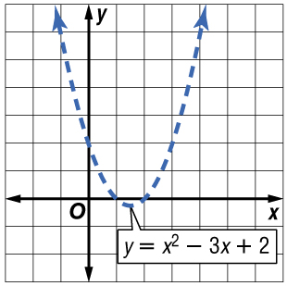
Example 1
Graph a Quadratic Inequality
Graph y > x² – 3x + 2.
Step 1 Graph the related quadratic equation, y = x² – 3x + 2. Since the inequality symbol is >, the parabola should be dashed.
>

Slide 6
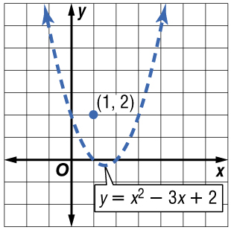
Example 1
Graph a Quadratic Inequality
Step 2 Test a point inside the parabola, such as (1, 2).
y > x² – 3x + 2
?
2 > 1² – 3(1) + 2
?
2 > 1 – 3 + 2
2 > 0
✓
So, (1, 2) is a solution of the inequality.
>

Slide 7
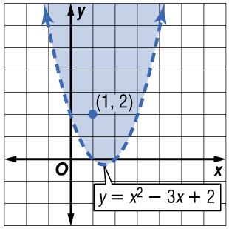
Example 1
Graph a Quadratic Inequality
Step 3 Shade the region inside the parabola that contains the point (1, 2).
Answer:
>

Slide 8
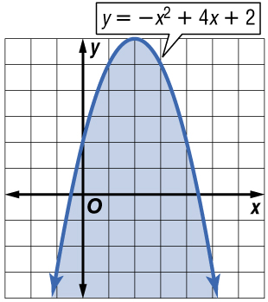
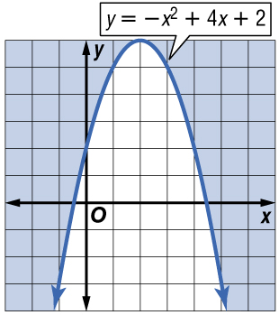
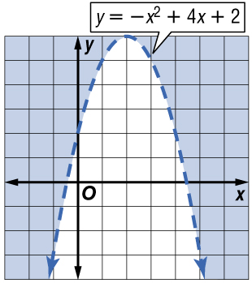
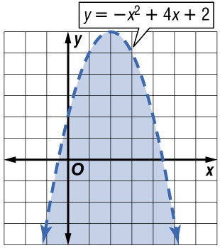
Example 1
Which is the graph of y < –x² + 4x + 2?
A. B.
C. D.
A
B
C
D

Slide 9
Example 2
Solve ax ² + bx + c < 0 by Graphing
Solve x ² – 4x + 3 < 0 by graphing.
The solution consists of the x-values for which the graph of the related quadratic function lies below the x-axis. Begin by finding the roots of the related equation.
x ² – 4x + 3 = 0 Related equation
(x – 3)(x – 1) = 0 Factor.
x – 3 = 0 or x – 1 = 0 Zero Product Property
x = 3 x = 1 Solve each equation.

Slide 10
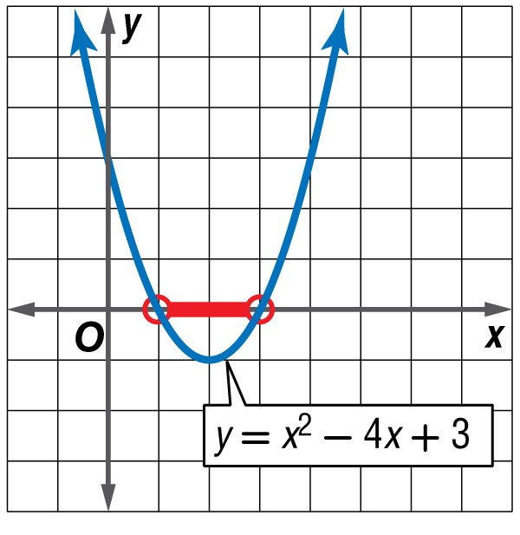
Example 2
Solve ax ² + bx + c < 0 by Graphing
Sketch the graph of the parabola that has x-intercepts at 3 and 1. The graph should open up since a > 0. The graph lies below the x-axis to the right of x = 1 and to the left of x = 3.
Answer: The solution set is {x | 1 < x < 3}.

Slide 11
Example 2
What is the solution to the inequality x ² + 5x + 6 < 0?
A. {x | –3 < x < –2}
B. {x | x < –3 or x > –2}
C. {x | 2 < x < 3}
D. {x | x < 2 or x > 3}
A
B
C
D

Slide 12
Example 3
Solve ax ² + bx + c ≥ 0 by Graphing
Solve 0 ≤ –2x² – 6x + 1 by graphing.
This inequality can be rewritten as –2x² – 6x + 1 ≥ 0. The solution consists of the x-values for which the graph of the related quadratic equation lies on and above the x-axis. Begin by finding roots of the related equation.
–2x² – 6x + 1 = 0 Related equation
Use the Quadratic Formula.
Replace a with –2, b with –6, and c with 1.

Slide 13
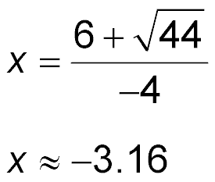
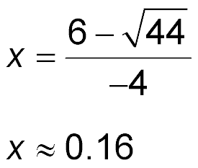
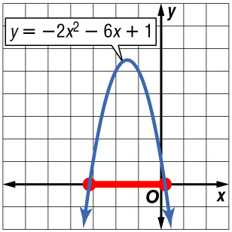
Example 3
Solve ax ² + bx + c ≥ 0 by Graphing
or Simplify and write as two equations.
Simplify.
Sketch the graph of the parabola that has x-intercepts of –3.16 and 0.16. The graph should open down since a < 0.
Answer: The graph lies on and above the x-axis at x = 0.16 and x = –3.16 and between these two values. The solution set of the inequality is approximately {x | –3.16 ≤ x ≤ 0.16}.

Slide 14
Example 3
Solve ax ² + bx + c ≥ 0 by Graphing
Check Test one value of x less than –3.16, one between –3.16 and 0.16, and one greater than 0.16 in the original inequality.
Test x = –4.
Test x = 0.
0 ≤ –2x² – 6x + 1
0 ≤ –2x² – 6x + 1
?
?
0 ≤ –2(–4)² – 6(–4) + 1
0 ≤ –2(0)² – 6(0) + 1
0 ≤ –7
0 ≤ 1
✓
Test x = 1.
0 ≤ –2x² – 6x + 1
?
0 ≤ –2(1)² – 6(1) + 1
0 ≤ –7

Slide 15
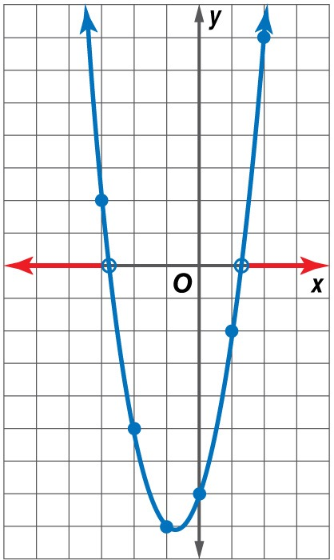
Example 3
Solve 2x² + 3x – 7 ≥ 0 by graphing.
A. {x | –2.77 ≤ x ≤ 1.27}
B. {x | –1.27 ≤ x ≤ 2.77}
C. {x | x ≤ –2.77 or x ≥ 1.27}
D. {x | x ≤ –1.27 or x ≥ 2.77}
A
B
C
D

Slide 16
Example 4
Solve a Quadratic Inequality
SPORTS The height of a ball above the ground after it is thrown upwards at 40 feet per second can be modeled by the function h(x) = 40x – 16x ², where the height h(x) is given in feet and the time x is in seconds. At what time in its flight is the ball within 15 feet of the ground?
The function h(x) describes the height of the ball. Therefore, you want to find values of x for which h(x) ≤ 15.
h(x) ≤ 15 Original inequality
40x – 16x ² ≤ 15 h(x) = 40x – 16x ²
–16x ² + 40x – 15 ≤ 0 Subtract 15 from each side.

Slide 17
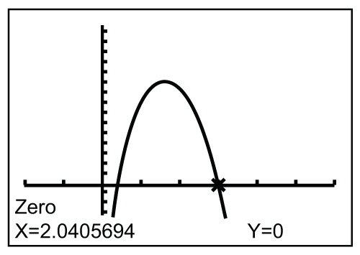
Example 4
Solve a Quadratic Inequality
Graph the related function –16x ² + 40x – 15 = 0 using a graphing calculator.
The zeros are about 0.46 and 2.04. The graph lies below the x-axis when x < 0.46 or x > 2.04.
Answer: Thus, the ball is within 15 feet of the ground for the first 0.46 second of its flight, from 0 to 0.46 second, and again after 2.04 seconds until the ball hits the ground at 2.5 seconds.

Slide 18
Example 4
SPORTS The height of a ball above the ground after it is thrown upwards at 28 feet per second can be modeled by the function h(x) = 28x – 16x ², where the height h(x) is given in feet and the time x is in seconds. At what time in its flight is the ball within 10 feet of the ground?
A. for the first 0.5 second and again after 1.25 seconds
B. for the first 0.5 second only
C. between 0.5 second and 1.25 seconds
D. It is never within 10 feet of the ground.
A
B
C
D

Slide 19
Example 5
Solve a Quadratic Inequality Algebraically
Solve x² + x ≤ 2 algebraically.
First, solve the related quadratic equation x² + x = 2.
x² + x = 2 Related quadratic equation
x² + x – 2 = 0 Subtract 2 from each side.
(x + 2)(x – 1) = 0 Factor.
x + 2 = 0 or x – 1 = 0 Zero Product Property
x = –2 x = 1 Solve each equation.

Slide 20
Example 5
Solve a Quadratic Inequality Algebraically
Plot –2 and 1 on a number line. Use closed circles since these solutions are included. Notice that the number line is separated into 3 intervals.
Test a value in each interval to see if it satisfies the original inequality.

Slide 21
Example 5
Solve a Quadratic Inequality Algebraically
Answer: The solution set is {x | –2 ≤ x ≤ 1}. This is shown on the number line below.

Slide 22
Example 5
Solve x² + 5x ≤ –6 algebraically. What is the solution?
A. {x | –3 ≤ x ≤ –2}
B. {x | x ≥ –2 or x ≤ –3}
C. {x | 1 ≤ x ≤ 6}
D. {x | –6 ≤ x ≤ –1}
A
B
C
D

Slide 23
End of the Lesson

